Slide 1
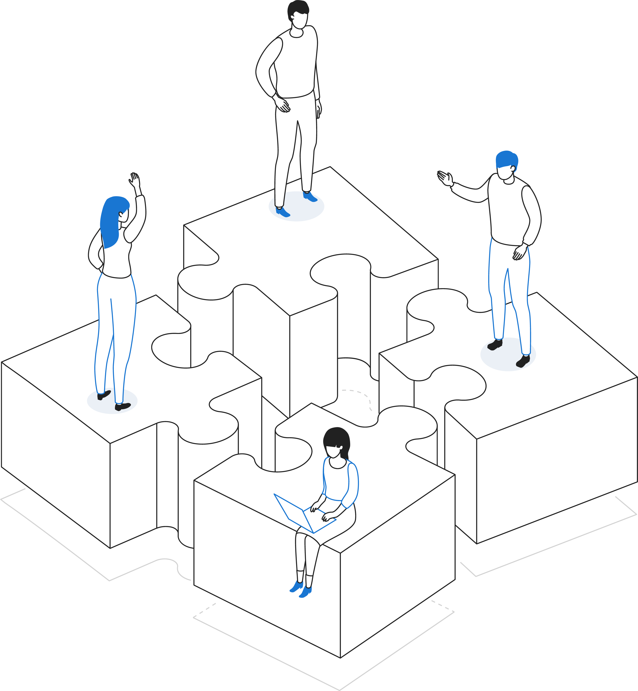

Return-to-Work Guide for Employees

Slide 2
Welcome back!
As we begin our phased-in return to work and begin this “new normal” in our workplace, we are placing primary importance on the health and safety of our employees and the public. We are following guidance from local and state officials to implement policies and safety measures which will be required for on-site staff as well as visitors who are accessing “in-person” services in our building.
We are committed to providing access to all essential services in a safe, responsible, and effective manner.

Slide 3

What we are doing:
All employees and visitors entering our building will be screened for COVID-19 symptoms (including temperature) and possible exposure.
Face coverings are required for visitors.
Face coverings are required for staff when outside their personal workspace or when working directly with visitors.
Common areas and frequently touched surfaces are being cleaned daily. Cleaning supplies will be available, and employees are encouraged to clean and disinfect workspaces throughout the workday.
Hand sanitizer is provided throughout the building.
Posters are displayed with reminders on how to prevent the spread of germs.
Wall and floor signage has been installed to maintain social distancing.
The agency will be closed to the public on Fridays to allow for deep cleaning and sanitation of common areas.
Person-to-person contacts are revised to allow for social distancing.
Common areas have reduced seating and capacity limits.

Slide 4

What you can do upon return to work:
Undergo daily health assessment and wear a face covering when outside your work space or working directly with the public.
Maintain social distancing practices in the workplace.
Clean and sanitize your work area daily.
Wash your hands frequently or use hand sanitizer
Cover your nose and mouth when sneezing or coughing.
Avoid touching your face.
Avoid using other employees’ phones, desks, offices or other work tools and equipment, when possible.
Stay home or go home if you are sick.
Talk to your supervisor if you have concerns specific to your circumstances
Follow all agency policies and prescribed practices.
Be kind. Understand that this is a stressful time for everyone, and an extra bit of kindness right now can go a long way.

Slide 5

Frequently Asked Questions
When will all employees return to work?
We are taking a phased approach to our return-to-work plan. The first phase will include staff whose work:
Supports “in-person” access to services (OMJ Center, Resource Room).
Cannot be fully and efficiently performed from an off-site location (some fiscal activities).
Supports on-site operational functions and activities (mail, fax distribution, etc.).
Subsequent phases of staff redeployment will be dependent upon:
The nature of the work and the degree to which on-site staff are required to accommodate the needs of clients, providers, and other community partners.
Changes in federal and state program policy which require increased staff response.
Changes in public health policy which no longer encourage remote work.
We will continue to monitor public health information and adhere to the Responsible Restart Ohio guidance as issued from the Governor’s office.
A
sta should discuss your specific circumstances with your manager.

Slide 6

Frequently Asked Questions
Is it safe to return to work?
We are taking every precaution to ensure our workplace is safe. We are following federal health and safety guidelines as well as guidance from our state and local officials. We have implemented practices such as daily employee health screenings social distancing, required use of face coverings, and increased cleaning and sanitation practices to keep our workplace healthy.
As we slowly introduce staff and visitors into our workplace, it is everyone’s responsibility to make sure that safety protocols are followed. We all will be participating in all levels of precaution. With everyone’s effort, we can continue to protect each other and our community

Slide 7


Frequently Asked Questions, cont.
What if I have to make a “home visit”?
Services normally provided in the home should be done virtually if possible. If a virtual meeting is not possible, you will need to complete a health questionnaire with the client prior to the visit. If the questionnaire responses indicate a risk of exposure to COVID19, the visit should be rescheduled. Contact your supervisor for further direction in how to provide services.
*See Return-to-Work Policy for more detail.
Will I need to change my work schedule when I return?
No – not initially. We don’t anticipate any change in work schedule for those returning in the first phase of the Return-to-Work plan. With a limited number of staff in the building, we will be able to maintain adequate social distancing. Staff are to refrain from congregating in common areas during breaks, lunch, etc.

Slide 8


Frequently Asked Questions, cont.
Do people have to answer the health questions at work?
Yes. All employees and visitors will be required to answer questions regarding COVID-19 symptoms before entering our building. Visitors who refuse to answer health screening questions will not be permitted entry into the building. Those visitors uncomfortable with health screening will be given a “Resource Card” which provides alternative methods to access agency staff and services. Employees are expected to adhere to all daily safety protocols as outlined in the Return-to-Work Policy.
What should I do if I feel sick?
Stay home or go home. Employees who feel ill should notify their supervisor per the regular attendance policy and not report to work. If you are already at work and begin feeling sick, you should notify your supervisor of your symptoms and go home immediately. You will be asked to monitor your symptoms and seek direction from your health care provider regarding returning to work in accordance with agency policy.

Slide 9


Frequently Asked Questions, cont.
Do I have to wear a mask at work?
Yes. We are following the Responsible Restart Ohio guidance for office environments which mandates employees to wear a mask or face covering. We are also requiring this of visitors to our building. We are providing reusable masks to staff and disposable masks to visitors.
Staff can wear their own face coverings as long as meet CDC guidelines.
Staff do not need to wear a mask while in their personal work space.
Staff do need to wear a mask in common areas and when working with the public.
Will we have in-person meetings with clients?
Yes, with safeguards. In order maintain adequate social distancing, in-person meetings will be by appointment only and held in a space which is large enough to allow for distancing between participants. In addition to distancing, masks will be required and a plexiglass barrier will be in place as an added safety measure.
We will continue to encourage virtual client contact via phone, email, or other video platforms when appropriate.

Slide 10


Frequently Asked Questions, cont.
How will positive cases of COVID-19 be handled in the workplace?
Despite all precautionary measures, there is always a risk of workplace exposure to communicable diseases. Should an employee contract COVID-19 and expose others in our workplace, we will contact the Marion Public Health Department and under their direction, inform all employees of the possible exposure. The Health Department will guide actions for isolation and quarantining of staff. Professional deep cleaning and sanitizing will be employed prior to staff returning to on-site work.
When will things go back to normal?
We will have a new normal. The COVID19 experience has been “the great revealer”. Our shared experience has revealed our potential for adapting to change, thinking creatively, and maintaining focus on our purpose. We have all learned new (and sometimes better) ways to serve which will continue past the health crisis.
When we come back together in one space, we will be ever more grateful and ever more focused on doing what is right for all people.

Slide 11






Changes You May See at Work
In the months to come, we will continually be monitoring the pandemic circumstances and will consider implementing additional technology to keep our workplace safe going forward. Some of the new technology you may experience includes:
Digital Signatures
(DocuSign or Adobe Sign)
Touchless Technology
(lights, dispensers)
Motion-activated cameras and intercom buttons (Ring Device)
Video Conferencing Apps for Meetings
Body temperature scanning devices

